Slide 1
JAVA BOOTCAMP DAY 01
Presented by
G2Academy

Slide 2
Software Development Life Cycle SDLC
Notes:
How presentation will benefit audience: Adult learners are more interested in a subject if they know how or why it is important to them.
Presenter’s level of expertise in the subject: Briefly state your credentials in this area, or explain why participants should listen to you.

Slide 3
What is SDLC?
SOFTWARE DEVELOPMENT LIFECYCLE (SDLC) is a systematic process for building software that ensures the quality and correctness of the software built.
SDLC process aims to produce high-quality software that meets customer expectations.
The system development should be complete in the pre-defined time frame and cost.
SDLC consists of a detailed plan which explains how to plan, build, and maintain specific software.
Every phase of the SDLC life cycle has its own process and deliverables that feed into the next phase.
Notes:
Lesson descriptions should be brief.

Slide 4
Why SDLC?
Here, are prime reasons why SDLC is important for developing a software system.
It offers a basis for project planning, scheduling, and estimating
Provides a framework for a standard set of activities and deliverables
It is a mechanism for project tracking and control
Increases visibility of project planning to all involved stakeholders of the development process
Increased and enhance development speed
Improved client relations
Helps you to decrease project risk and project management plan overhead
Notes:
Lesson descriptions should be brief.

Slide 5
SDLC Phases
The entire SDLC process divided into the following stages:
Phase 1: Requirement collection and analysis
Phase 2: Feasibility study:
Phase 3: Design:
Phase 4: Coding:
Phase 5: Testing:
Phase 6: Installation/Deployment:
Phase 7: Maintenance:
Notes:
Lesson descriptions should be brief.

Slide 6
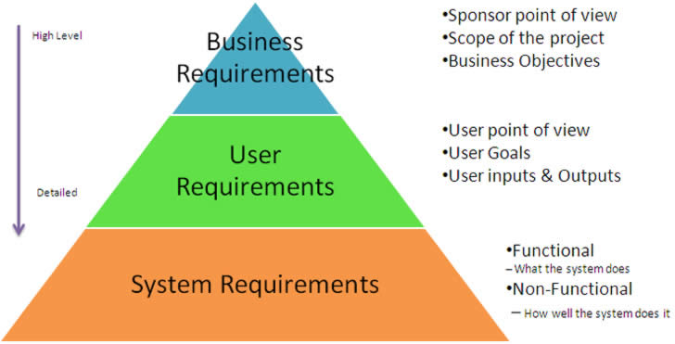
Phase 1: Requirement collection and analysis:
The requirement is the first stage in the SDLC process. It is conducted by the senior team members with inputs from all the stakeholders and domain experts in the industry. Planning for the quality assurance requirements and recognization of the risks involved is also done at this stage.
This stage gives a clearer picture of the scope of the entire project and the anticipated issues, opportunities, and directives which triggered the project.
Requirements Gathering stage need teams to get detailed and precise requirements. This helps companies to finalize the necessary timeline to finish the work of that system.
Notes:
Lesson descriptions should be brief.

Slide 7
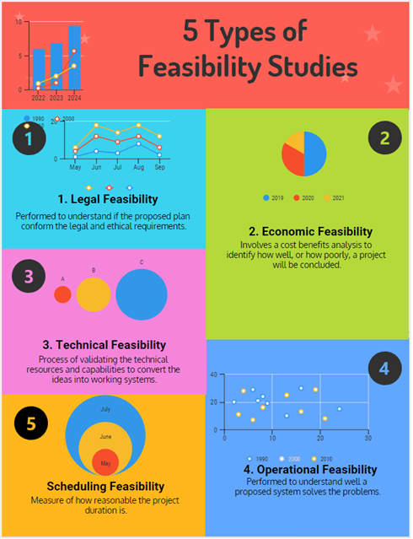
Phase 2: Feasibility study:
Once the requirement analysis phase is completed the next step is to define and document software needs. This process conducted with the help of 'Software Requirement Specification' document also known as 'SRS' document. It includes everything which should be designed and developed during the project life cycle.
Notes:
Lesson descriptions should be brief.

Slide 8
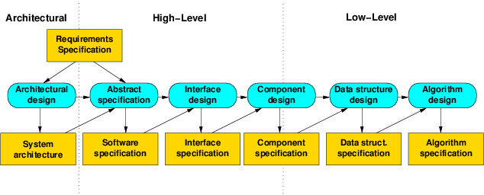
Phase 3: Design:
In this third phase, the system and software design documents are prepared as per the requirement specification document. This helps define overall system architecture.
This design phase serves as input for the next phase of the model.
Notes:
Lesson descriptions should be brief.

Slide 9
Phase 3: Design: High-Level Design (HLD)
Brief description and name of each module
An outline about the functionality of every module
Interface relationship and dependencies between modules
Database tables identified along with their key elements
Complete architecture diagrams along with technology details
Notes:
Lesson descriptions should be brief.

Slide 10
Phase 3: Design: Low-Level Design(LLD)
Functional logic of the modules
Database tables, which include type and size
Complete detail of the interface
Addresses all types of dependency issues
Listing of error messages
Complete input and outputs for every module
Notes:
Lesson descriptions should be brief.

Slide 11
Phase 4: Coding:
Once the system design phase is over, the next phase is coding. In this phase, developers start build the entire system by writing code using the chosen programming language.
In the coding phase, tasks are divided into units or modules and assigned to the various developers. It is the longest phase of the Software Development Life Cycle process.
In this phase, Developer needs to follow certain predefined coding guidelines. They also need to use programming tools like compiler, interpreters, debugger to generate and implement the code.
Notes:
Lesson descriptions should be brief.

Slide 12
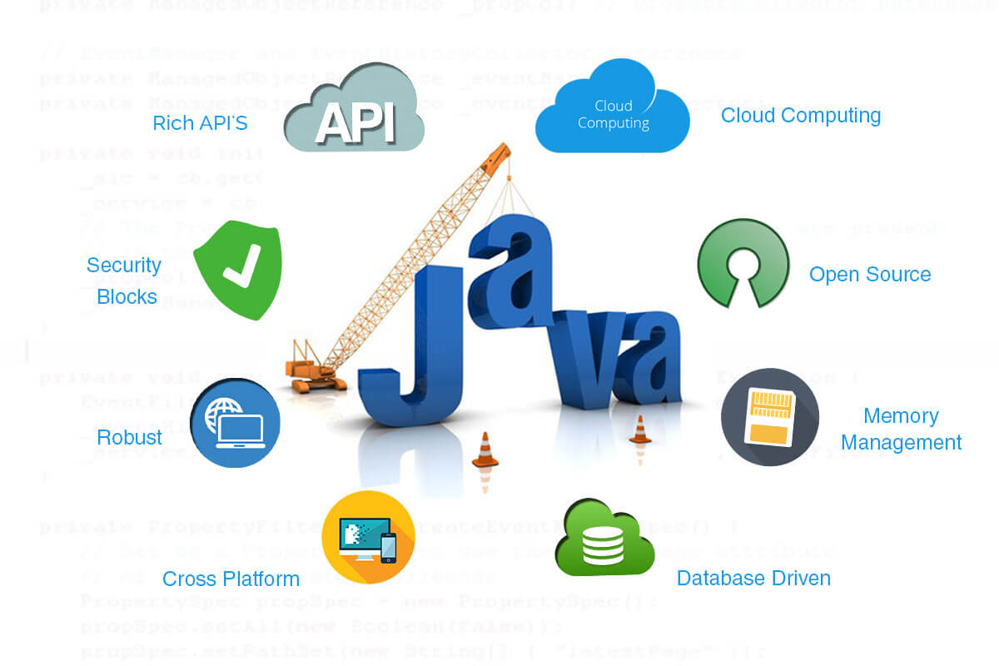
Phase 4: Coding:
Notes:
Lesson descriptions should be brief.

Slide 13
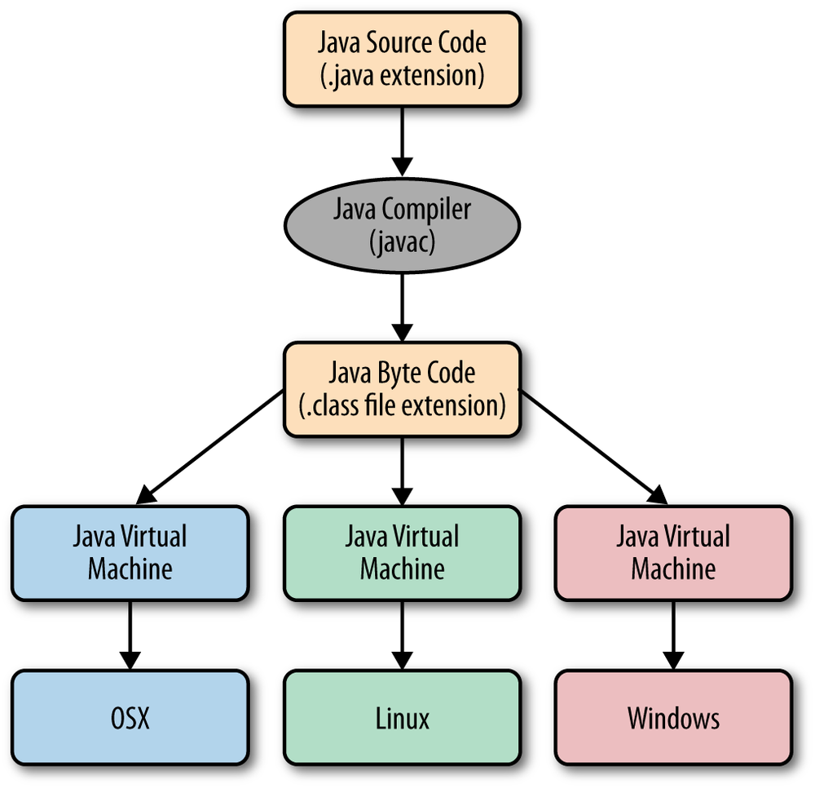
Phase 4: Coding:
Notes:
Lesson descriptions should be brief.

Slide 14
Phase 5: Testing:
Once the software is complete, and it is deployed in the testing environment. The testing team starts testing the functionality of the entire system. This is done to verify that the entire application works according to the customer requirement.
During this phase, QA and testing team may find some bugs/defects which they communicate to developers. The development team fixes the bug and send back to QA for a re-test. This process continues until the software is bug-free, stable, and working according to the business needs of that system.
Notes:
Lesson descriptions should be brief.

Slide 15
Phase 6: Installation/Deployment:
Once the software testing phase is over and no bugs or errors left in the system then the final deployment process starts. Based on the feedback given by the project manager, the final software is released and checked for deployment issues if any.
Notes:
Lesson descriptions should be brief.

Slide 16
Phase 7: Maintenance:
Once the system is deployed, and customers start using the developed system, following 3 activities occur
Bug fixing - bugs are reported because of some scenarios which are not tested at all
Upgrade - Upgrading the application to the newer versions of the Software
Enhancement - Adding some new features into the existing software
The main focus of this SDLC phase is to ensure that needs continue to be met and that the system continues to perform as per the specification mentioned in the first phase.
Notes:
Lesson descriptions should be brief.

Slide 17
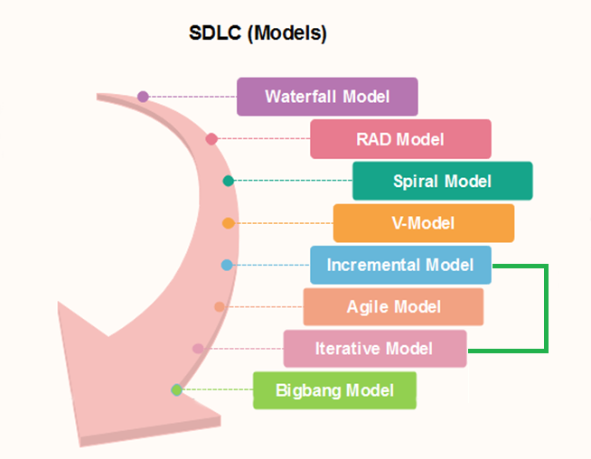
Popular SDLC models
Notes:
Lesson descriptions should be brief.

Slide 18
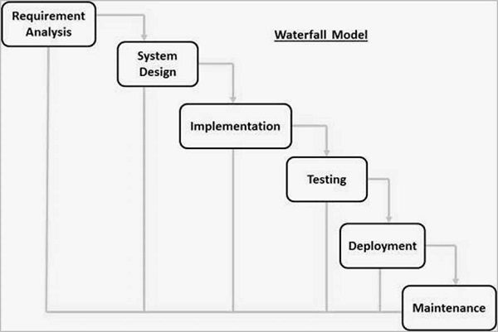
Waterfall Model
Waterfall approach was first SDLC Model to be used widely in Software Engineering to ensure success of the project. In "The Waterfall" approach, the whole process of software development is divided into separate phases. In this Waterfall model, typically, the outcome of one phase acts as the input for the next phase sequentially.
The following illustration is a representation of the different phases of the Waterfall Model.
Notes:
Lesson descriptions should be brief.

Slide 19
Waterfall Model
The sequential phases in Waterfall model are −
Requirement Gathering and analysis − All possible requirements of the system to be developed are captured in this phase and documented in a requirement specification document.
System Design − The requirement specifications from first phase are studied in this phase and the system design is prepared. This system design helps in specifying hardware and system requirements and helps in defining the overall system architecture.
Implementation − With inputs from the system design, the system is first developed in small programs called units, which are integrated in the next phase. Each unit is developed and tested for its functionality, which is referred to as Unit Testing.
Integration and Testing − All the units developed in the implementation phase are integrated into a system after testing of each unit. Post integration the entire system is tested for any faults and failures.
Deployment of system − Once the functional and non-functional testing is done; the product is deployed in the customer environment or released into the market.
Maintenance − There are some issues which come up in the client environment. To fix those issues, patches are released. Also to enhance the product some better versions are released. Maintenance is done to deliver these changes in the customer environment.
All these phases are cascaded to each other in which progress is seen as flowing steadily downwards (like a waterfall) through the phases. The next phase is started only after the defined set of goals are achieved for previous phase and it is signed off, so the name "Waterfall Model". In this model, phases do not overlap.
Notes:
Lesson descriptions should be brief.

Slide 20
Waterfall Model
Every software developed is different and requires a suitable SDLC approach to be followed based on the internal and external factors. Some situations where the use of Waterfall model is most appropriate are −
Requirements are very well documented, clear and fixed.
Product definition is stable.
Technology is understood and is not dynamic.
There are no ambiguous requirements.
Ample resources with required expertise are available to support the product.
The project is short.
Notes:
Lesson descriptions should be brief.

Slide 21
Waterfall Model - Advantages
The advantages of waterfall development are that it allows for departmentalization and control. A schedule can be set with deadlines for each stage of development and a product can proceed through the development process model phases one by one.
Development moves from concept, through design, implementation, testing, installation, troubleshooting, and ends up at operation and maintenance. Each phase of development proceeds in strict order.
Some of the major advantages of the Waterfall Model are as follows −
Simple and easy to understand and use
Easy to manage due to the rigidity of the model. Each phase has specific deliverables and a review process.
Phases are processed and completed one at a time.
Works well for smaller projects where requirements are very well understood.
Clearly defined stages.
Well understood milestones.
Easy to arrange tasks.
Process and results are well documented.
Notes:
Lesson descriptions should be brief.

Slide 22
Waterfall Model - Disadvantages
The disadvantage of waterfall development is that it does not allow much reflection or revision. Once an application is in the testing stage, it is very difficult to go back and change something that was not well-documented or thought upon in the concept stage.
The major disadvantages of the Waterfall Model are as follows −
No working software is produced until late during the life cycle.
High amounts of risk and uncertainty.
Not a good model for complex and object-oriented projects.
Poor model for long and ongoing projects.
Not suitable for the projects where requirements are at a moderate to high risk of changing. So, risk and uncertainty is high with this process model.
It is difficult to measure progress within stages.
Cannot accommodate changing requirements.
Adjusting scope during the life cycle can end a project.
Integration is done as a "big-bang. at the very end, which doesn't allow identifying any technological or business bottleneck or challenges early.
Notes:
Lesson descriptions should be brief.

Slide 23
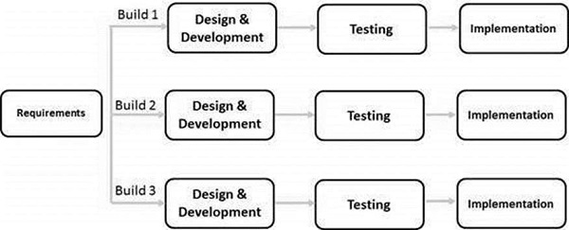
Iterative & Incremental Model
Iterative process starts with a simple implementation of a subset of the software requirements and iteratively enhances the evolving versions until the full system is implemented. At each iteration, design modifications are made and new functional capabilities are added. The basic idea behind this method is to develop a system through repeated cycles (iterative) and in smaller portions at a time (incremental).
The following illustration is a representation of the Iterative and Incremental model −
Notes:
Example objectives
At the end of this lesson, you will be able to:
Save files to the team Web server.
Move files to different locations on the team Web server.
Share files on the team Web server.

Slide 24
Iterative & Incremental Model
Iterative and Incremental development is a combination of both iterative design or iterative method and incremental build model for development. "During software development, more than one iteration of the software development cycle may be in progress at the same time." This process may be described as an "evolutionary acquisition" or "incremental build" approach."
In this incremental model, the whole requirement is divided into various builds. During each iteration, the development module goes through the requirements, design, implementation and testing phases. Each subsequent release of the module adds function to the previous release. The process continues till the complete system is ready as per the requirement.
The key to a successful use of an iterative software development lifecycle is rigorous validation of requirements, and verification & testing of each version of the software against those requirements within each cycle of the model. As the software evolves through successive cycles, tests must be repeated and
Notes:
Example objectives
At the end of this lesson, you will be able to:
Save files to the team Web server.
Move files to different locations on the team Web server.
Share files on the team Web server.

Slide 25
Iterative & Incremental Model
Like other SDLC models, Iterative and incremental development has some specific applications in the software industry. This model is most often used in the following scenarios −
Requirements of the complete system are clearly defined and understood.
Major requirements must be defined; however, some functionalities or requested enhancements may evolve with time.
There is a time to the market constraint.
A new technology is being used and is being learnt by the development team while working on the project.
Resources with needed skill sets are not available and are planned to be used on contract basis for specific iterations.
There are some high-risk features and goals which may change in the future.
Notes:
Example objectives
At the end of this lesson, you will be able to:
Save files to the team Web server.
Move files to different locations on the team Web server.
Share files on the team Web server.

Slide 26
Iterative & Incremental Model Pros & Con
The advantage of this model is that there is a working model of the system at a very early stage of development, which makes it easier to find functional or design flaws. Finding issues at an early stage of development enables to take corrective measures in a limited budget.
The disadvantage with this SDLC model is that it is applicable only to large and bulky software development projects. This is because it is hard to break a small software system into further small serviceable increments/modules.
Notes:
Example objectives
At the end of this lesson, you will be able to:
Save files to the team Web server.
Move files to different locations on the team Web server.
Share files on the team Web server.

Slide 27
Iterative & Incremental Model - Advantages
Some working functionality can be developed quickly and early in the life cycle.
Results are obtained early and periodically.
Parallel development can be planned.
Progress can be measured.
Less costly to change the scope/requirements.
Testing and debugging during smaller iteration is easy.
Risks are identified and resolved during iteration; and each iteration is an easily managed milestone.
Easier to manage risk - High risk part is done first.
With every increment, operational product is delivered.
Issues, challenges and risks identified from each increment can be utilized/applied to the next increment.
Risk analysis is better.
It supports changing requirements.
Initial Operating time is less.
Better suited for large and mission-critical projects.
During the life cycle, software is produced early which facilitates customer evaluation and feedback.
Notes:
Example objectives
At the end of this lesson, you will be able to:
Save files to the team Web server.
Move files to different locations on the team Web server.
Share files on the team Web server.

Slide 28
Iterative & Incremental Model - Disadvantages
More resources may be required.
Although cost of change is lesser, but it is not very suitable for changing requirements.
More management attention is required.
System architecture or design issues may arise because not all requirements are gathered in the beginning of the entire life cycle.
Defining increments may require definition of the complete system.
Not suitable for smaller projects.
Management complexity is more.
End of project may not be known which is a risk.
Highly skilled resources are required for risk analysis.
Projects progress is highly dependent upon the risk analysis phase.
Notes:
Example objectives
At the end of this lesson, you will be able to:
Save files to the team Web server.
Move files to different locations on the team Web server.
Share files on the team Web server.

Slide 29
Spiral Model
The spiral model combines the idea of iterative development with the systematic, controlled aspects of the waterfall model.
This Spiral model is a combination of iterative development process model and sequential linear development model i.e. the waterfall model with a very high emphasis on risk analysis.
It allows incremental releases of the product or incremental refinement through each iteration around the spiral.
Notes:
Example objectives
At the end of this lesson, you will be able to:
Save files to the team Web server.
Move files to different locations on the team Web server.
Share files on the team Web server.

Slide 30
Spiral Model
The spiral model has four phases. A software project repeatedly passes through these phases in iterations called Spirals.
Identification
This phase starts with gathering the business requirements in the baseline spiral. In the subsequent spirals as the product matures, identification of system requirements, subsystem requirements and unit requirements are all done in this phase.
This phase also includes understanding the system requirements by continuous communication between the customer and the system analyst. At the end of the spiral, the product is deployed in the identified market.
Design
The Design phase starts with the conceptual design in the baseline spiral and involves architectural design, logical design of modules, physical product design and the final design in the subsequent spirals.
Notes:
Example objectives
At the end of this lesson, you will be able to:
Save files to the team Web server.
Move files to different locations on the team Web server.
Share files on the team Web server.

Slide 31
Spiral Model
Construct or Build
The Construct phase refers to production of the actual software product at every spiral. In the baseline spiral, when the product is just thought of and the design is being developed a POC (Proof of Concept) is developed in this phase to get customer feedback.
Then in the subsequent spirals with higher clarity on requirements and design details a working model of the software called build is produced with a version number. These builds are sent to the customer for feedback.
Evaluation and Risk Analysis
Risk Analysis includes identifying, estimating and monitoring the technical feasibility and management risks, such as schedule slippage and cost overrun. After testing the build, at the end of first iteration, the customer evaluates the software and provides feedback.
Notes:
Example objectives
At the end of this lesson, you will be able to:
Save files to the team Web server.
Move files to different locations on the team Web server.
Share files on the team Web server.

Slide 32
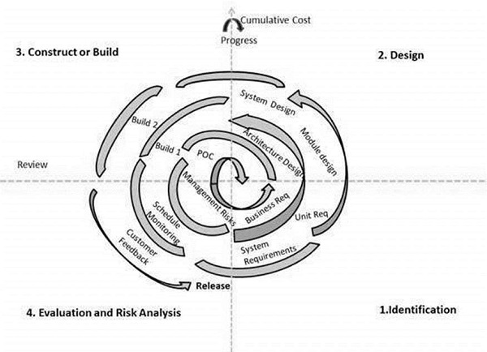
Spiral Model
The following illustration is a representation of the Spiral Model, listing the activities in each phase.
Based on the customer evaluation, the software development process enters the next iteration and subsequently follows the linear approach to implement the feedback suggested by the customer. The process of iterations along the spiral continues throughout the life of the software.
Notes:
Example objectives
At the end of this lesson, you will be able to:
Save files to the team Web server.
Move files to different locations on the team Web server.
Share files on the team Web server.

Slide 33
Spiral Model
The Spiral Model is widely used in the software industry as it is in sync with the natural development process of any product, i.e. learning with maturity which involves minimum risk for the customer as well as the development firms.
The following pointers explain the typical uses of a Spiral Model −
When there is a budget constraint and risk evaluation is important.
For medium to high-risk projects.
Long-term project commitment because of potential changes to economic priorities as the requirements change with time.
Customer is not sure of their requirements which is usually the case.
Requirements are complex and need evaluation to get clarity.
New product line which should be released in phases to get enough customer feedback.
Significant changes are expected in the product during the development cycle.
Notes:
Example objectives
At the end of this lesson, you will be able to:
Save files to the team Web server.
Move files to different locations on the team Web server.
Share files on the team Web server.

Slide 34
Spiral Model Pros & Cons
The advantage of spiral lifecycle model is that it allows elements of the product to be added in, when they become available or known. This assures that there is no conflict with previous requirements and design.
This method is consistent with approaches that have multiple software builds and releases which allows making an orderly transition to a maintenance activity. Another positive aspect of this method is that the spiral model forces an early user involvement in the system development effort.
On the other side, it takes a very strict management to complete such products and there is a risk of running the spiral in an indefinite loop. So, the discipline of change and the extent of taking change requests is very important to develop and deploy the product successfully.
Notes:
Example objectives
At the end of this lesson, you will be able to:
Save files to the team Web server.
Move files to different locations on the team Web server.
Share files on the team Web server.

Slide 35
Spiral Model - Advantages
Changing requirements can be accommodated.
Allows extensive use of prototypes.
Requirements can be captured more accurately.
Users see the system early.
Development can be divided into smaller parts and the risky parts can be developed earlier which helps in better risk management.
Notes:
Example objectives
At the end of this lesson, you will be able to:
Save files to the team Web server.
Move files to different locations on the team Web server.
Share files on the team Web server.

Slide 36
Spiral Model - Disadvantages
Management is more complex.
End of the project may not be known early.
Not suitable for small or low risk projects and could be expensive for small projects.
Process is complex
Spiral may go on indefinitely.
Large number of intermediate stages requires excessive documentation.
Notes:
Example objectives
At the end of this lesson, you will be able to:
Save files to the team Web server.
Move files to different locations on the team Web server.
Share files on the team Web server.

Slide 37
V-Model
The V-model is an SDLC model where execution of processes happens in a sequential manner in a V-shape. It is also known as Verification and Validation model.
The V-Model is an extension of the waterfall model and is based on the association of a testing phase for each corresponding development stage.
This means that for every single phase in the development cycle, there is a directly associated testing phase. This is a highly-disciplined model and the next phase starts only after completion of the previous phase.
Notes:
Example objectives
At the end of this lesson, you will be able to:
Save files to the team Web server.
Move files to different locations on the team Web server.
Share files on the team Web server.

Slide 38
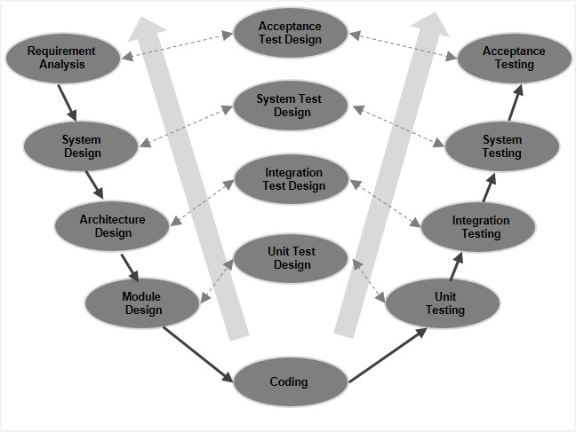
V-Model
Under the V-Model, the corresponding testing phase of the development phase is planned in parallel. So, there are Verification phases on one side of the ‘V’ and Validation phases on the other side. The Coding Phase joins the two sides of the V-Model.
The following illustration depicts the different phases in a V-Model of the SDLC.
Notes:
Example objectives
At the end of this lesson, you will be able to:
Save files to the team Web server.
Move files to different locations on the team Web server.
Share files on the team Web server.

Slide 39
V-Model Verification Phase
Business Requirement Analysis
This is the first phase in the development cycle where the product requirements are understood from the customer’s perspective. This phase involves detailed communication with the customer to understand his expectations and exact requirement. This is a very important activity and needs to be managed well, as most of the customers are not sure about what exactly they need. The acceptance test design planning is done at this stage as business requirements can be used as an input for acceptance testing.
System Design
Once you have the clear and detailed product requirements, it is time to design the complete system. The system design will have the understanding and detailing the complete hardware and communication setup for the product under development. The system test plan is developed based on the system design. Doing this at an earlier stage leaves more time for the actual test execution later.
Notes:
Example objectives
At the end of this lesson, you will be able to:
Save files to the team Web server.
Move files to different locations on the team Web server.
Share files on the team Web server.

Slide 40
V-Model Verification Phase
Architectural Design
Architectural specifications are understood and designed in this phase. Usually more than one technical approach is proposed and based on the technical and financial feasibility the final decision is taken. The system design is broken down further into modules taking up different functionality. This is also referred to as High Level Design (HLD).
The data transfer and communication between the internal modules and with the outside world (other systems) is clearly understood and defined in this stage. With this information, integration tests can be designed and documented during this stage.
Module Design
In this phase, the detailed internal design for all the system modules is specified, referred to as Low Level Design (LLD). It is important that the design is compatible with the other modules in the system architecture and the other external systems. The unit tests are an essential part of any development process and helps eliminate the maximum faults and errors at a very early stage. These unit tests can be designed at this stage based on the internal module designs.
Notes:
Example objectives
At the end of this lesson, you will be able to:
Save files to the team Web server.
Move files to different locations on the team Web server.
Share files on the team Web server.

Slide 41
V-Model Coding Phase
The actual coding of the system modules designed in the design phase is taken up in the Coding phase. The best suitable programming language is decided based on the system and architectural requirements.
The coding is performed based on the coding guidelines and standards. The code goes through numerous code reviews and is optimized for best performance before the final build is checked into the repository.
Notes:
Example objectives
At the end of this lesson, you will be able to:
Save files to the team Web server.
Move files to different locations on the team Web server.
Share files on the team Web server.

Slide 42
V-Model Validation Phase
Unit Testing
Unit tests designed in the module design phase are executed on the code during this validation phase. Unit testing is the testing at code level and helps eliminate bugs at an early stage, though all defects cannot be uncovered by unit testing.
Integration Testing
Integration testing is associated with the architectural design phase. Integration tests are performed to test the coexistence and communication of the internal modules within the system.
System Testing
System testing is directly associated with the system design phase. System tests check the entire system functionality and the communication of the system under development with external systems. Most of the software and hardware compatibility issues can be uncovered during this system test execution.
Acceptance Testing
Acceptance testing is associated with the business requirement analysis phase and involves testing the product in user environment. Acceptance tests uncover the compatibility issues with the other systems available in the user environment. It also discovers the non-functional issues such as load and performance defects in the actual user environment.
Notes:
Example objectives
At the end of this lesson, you will be able to:
Save files to the team Web server.
Move files to different locations on the team Web server.
Share files on the team Web server.

Slide 43
V-Model
V- Model application is almost the same as the waterfall model, as both the models are of sequential type. Requirements have to be very clear before the project starts, because it is usually expensive to go back and make changes. This model is used in the medical development field, as it is strictly a disciplined domain.
The following pointers are some of the most suitable scenarios to use the V-Model application.
Requirements are well defined, clearly documented and fixed.
Product definition is stable.
Technology is not dynamic and is well understood by the project team.
There are no ambiguous or undefined requirements.
The project is short.
Notes:
Example objectives
At the end of this lesson, you will be able to:
Save files to the team Web server.
Move files to different locations on the team Web server.
Share files on the team Web server.

Slide 44
V-Model Pros & Cons
The advantage of the V-Model method is that it is very easy to understand and apply. The simplicity of this model also makes it easier to manage.
The disadvantage is that the model is not flexible to changes and just in case there is a requirement change, which is very common in today’s dynamic world, it becomes very expensive to make the change.
Notes:
Example objectives
At the end of this lesson, you will be able to:
Save files to the team Web server.
Move files to different locations on the team Web server.
Share files on the team Web server.

Slide 45
V-Model - Advantages
This is a highly-disciplined model and Phases are completed one at a time.
Works well for smaller projects where requirements are very well understood.
Simple and easy to understand and use.
Easy to manage due to the rigidity of the model. Each phase has specific deliverables and a review process.
Notes:
Example objectives
At the end of this lesson, you will be able to:
Save files to the team Web server.
Move files to different locations on the team Web server.
Share files on the team Web server.

Slide 46
V-Model - Disadvantages
High risk and uncertainty.
Not a good model for complex and object-oriented projects.
Poor model for long and ongoing projects.
Not suitable for the projects where requirements are at a moderate to high risk of changing.
Once an application is in the testing stage, it is difficult to go back and change a functionality.
No working software is produced until late during the life cycle.
Notes:
Example objectives
At the end of this lesson, you will be able to:
Save files to the team Web server.
Move files to different locations on the team Web server.
Share files on the team Web server.

Slide 47
Big bang Model
The Big Bang model is an SDLC model where we do not follow any specific process. The development just starts with the required money and efforts as the input, and the output is the software developed which may or may not be as per customer requirement.
This Big Bang Model does not follow a process/procedure and there is a very little planning required. Even the customer is not sure about what exactly he wants and the requirements are implemented on the fly without much analysis.
Usually this model is followed for small projects where the development teams are very small.
Notes:
Example objectives
At the end of this lesson, you will be able to:
Save files to the team Web server.
Move files to different locations on the team Web server.
Share files on the team Web server.

Slide 48
Big bang Model
The Big Bang Model comprises of focusing all the possible resources in the software development and coding, with very little or no planning.
The requirements are understood and implemented as they come. Any changes required may or may not need to revamp the complete software.
This model is ideal for small projects with one or two developers working together and is also useful for academic or practice projects. It is an ideal model for the product where requirements are not well understood and the final release date is not given.
Notes:
Example objectives
At the end of this lesson, you will be able to:
Save files to the team Web server.
Move files to different locations on the team Web server.
Share files on the team Web server.

Slide 49
Big bang Model Pros & Cons
The advantage of this Big Bang Model is that it is very simple and requires very little or no planning. Easy to manage and no formal procedure are required.
However, the Big Bang Model is a very high risk model and changes in the requirements or misunderstood requirements may even lead to complete reversal or scraping of the project. It is ideal for repetitive or small projects with minimum risks.
Notes:
Example objectives
At the end of this lesson, you will be able to:
Save files to the team Web server.
Move files to different locations on the team Web server.
Share files on the team Web server.

Slide 50
Big bang Model - Advantages
This is a very simple model
Little or no planning required
Easy to manage
Very few resources required
Gives flexibility to developers
It is a good learning aid for new comers or students.
Notes:
Example objectives
At the end of this lesson, you will be able to:
Save files to the team Web server.
Move files to different locations on the team Web server.
Share files on the team Web server.

Slide 51
Big bang Model - Disadvantages
Very High risk and uncertainty.
Not a good model for complex and object-oriented projects.
Poor model for long and ongoing projects.
Can turn out to be very expensive if requirements are misunderstood.
Notes:
Example objectives
At the end of this lesson, you will be able to:
Save files to the team Web server.
Move files to different locations on the team Web server.
Share files on the team Web server.

Slide 52
Agile Model
Agile SDLC model is a combination of iterative and incremental process models with focus on process adaptability and customer satisfaction by rapid delivery of working software product. Agile Methods break the product into small incremental builds. These builds are provided in iterations. Each iteration typically lasts from about one to three weeks. Every iteration involves cross functional teams working simultaneously on various areas like −
Planning
Requirements Analysis
Design
Coding
Unit Testing and
Acceptance Testing.
At the end of the iteration, a working product is displayed to the customer and important stakeholders.
Notes:
Example objectives
At the end of this lesson, you will be able to:
Save files to the team Web server.
Move files to different locations on the team Web server.
Share files on the team Web server.

Slide 53
Agile Model
Agile model believes that every project needs to be handled differently and the existing methods need to be tailored to best suit the project requirements. In Agile, the tasks are divided to time boxes (small time frames) to deliver specific features for a release.
Iterative approach is taken and working software build is delivered after each iteration. Each build is incremental in terms of features; the final build holds all the features required by the customer.
Notes:
Example objectives
At the end of this lesson, you will be able to:
Save files to the team Web server.
Move files to different locations on the team Web server.
Share files on the team Web server.

Slide 54
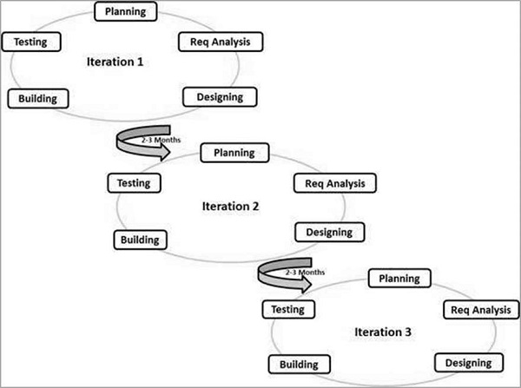
Agile Model
Here is a graphical illustration of the Agile Model −
Notes:
Example objectives
At the end of this lesson, you will be able to:
Save files to the team Web server.
Move files to different locations on the team Web server.
Share files on the team Web server.

Slide 55
Agile Model
The Agile thought process had started early in the software development and started becoming popular with time due to its flexibility and adaptability.
Following are the Agile Manifesto principles −
Individuals and interactions − In Agile development, self-organization and motivation are important, as are interactions like co-location and pair programming.
Working software − Demo working software is considered the best means of communication with the customers to understand their requirements, instead of just depending on documentation.
Customer collaboration − As the requirements cannot be gathered completely in the beginning of the project due to various factors, continuous customer interaction is very important to get proper product requirements.
Responding to change − Agile Development is focused on quick responses to change and continuous development.
Notes:
Example objectives
At the end of this lesson, you will be able to:
Save files to the team Web server.
Move files to different locations on the team Web server.
Share files on the team Web server.

Slide 56
Agile VS Traditional SDLC Models
Agile is based on the adaptive software development methods, whereas the traditional SDLC models like the waterfall model is based on a predictive approach. Predictive teams in the traditional SDLC models usually work with detailed planning and have a complete forecast of the exact tasks and features to be delivered in the next few months or during the product life cycle.
Predictive methods entirely depend on the requirement analysis and planning done in the beginning of cycle. Any changes to be incorporated go through a strict change control management and prioritization.
Agile uses an adaptive approach where there is no detailed planning and there is clarity on future tasks only in respect of what features need to be developed. There is feature driven development and the team adapts to the changing product requirements dynamically. The product is tested very frequently, through the release iterations, minimizing the risk of any major failures in future.
Customer Interaction is the backbone of this Agile methodology, and open communication with minimum documentation are the typical features of Agile development environment. The agile teams work in close collaboration with each other and are most often located in the same geographical location.
Notes:
Example objectives
At the end of this lesson, you will be able to:
Save files to the team Web server.
Move files to different locations on the team Web server.
Share files on the team Web server.

Slide 57
Agile Model - Advantages
Is a very realistic approach to software development.
Promotes teamwork and cross training.
Functionality can be developed rapidly and demonstrated.
Resource requirements are minimum.
Suitable for fixed or changing requirements
Delivers early partial working solutions.
Good model for environments that change steadily.
Minimal rules, documentation easily employed.
Enables concurrent development and delivery within an overall planned context.
Little or no planning required.
Easy to manage.
Gives flexibility to developers.
Notes:
Example objectives
At the end of this lesson, you will be able to:
Save files to the team Web server.
Move files to different locations on the team Web server.
Share files on the team Web server.

Slide 58
Agile Model - Disadvantages
Not suitable for handling complex dependencies.
More risk of sustainability, maintainability and extensibility.
An overall plan, an agile leader and agile PM practice is a must without which it will not work.
Strict delivery management dictates the scope, functionality to be delivered, and adjustments to meet the deadlines.
Depends heavily on customer interaction, so if customer is not clear, team can be driven in the wrong direction.
There is a very high individual dependency, since there is minimum documentation generated.
Transfer of technology to new team members may be quite challenging due to lack of documentation.
Notes:
Example objectives
At the end of this lesson, you will be able to:
Save files to the team Web server.
Move files to different locations on the team Web server.
Share files on the team Web server.

Slide 59
RAD Model
The RAD (Rapid Application Development) model is based on prototyping and iterative development with no specific planning involved.
The process of writing the software itself involves the planning required for developing the product.
Rapid Application Development focuses on gathering customer requirements through workshops or focus groups, early testing of the prototypes by the customer using iterative concept, reuse of the existing prototypes (components), continuous integration and rapid delivery.
Notes:
Lesson descriptions should be brief.

Slide 60
RAD Model
Rapid application development is a software development methodology that uses minimal planning in favor of rapid prototyping. A prototype is a working model that is functionally equivalent to a component of the product.
In the RAD model, the functional modules are developed in parallel as prototypes and are integrated to make the complete product for faster product delivery. Since there is no detailed preplanning, it makes it easier to incorporate the changes within the development process.
RAD projects follow iterative and incremental model and have small teams comprising of developers, domain experts, customer representatives and other IT resources working progressively on their component or prototype.
The most important aspect for this model to be successful is to make sure that the prototypes developed are reusable.
Notes:
Lesson descriptions should be brief.

Slide 61
RAD Model
RAD model distributes the analysis, design, build and test phases into a series of short, iterative development cycles. Following are the various phases of the RAD Model −
Business Modeling
The business model for the product under development is designed in terms of flow of information and the distribution of information between various business channels. A complete business analysis is performed to find the vital information for business, how it can be obtained, how and when is the information processed and what are the factors driving successful flow of information.
Data Modeling
The information gathered in the Business Modeling phase is reviewed and analyzed to form sets of data objects vital for the business. The attributes of all data sets is identified and defined. The relation between these data objects are established and defined in detail in relevance to the business model.
Notes:
Lesson descriptions should be brief.

Slide 62
RAD Model
Process Modeling
The data object sets defined in the Data Modeling phase are converted to establish the business information flow needed to achieve specific business objectives as per the business model. The process model for any changes or enhancements to the data object sets is defined in this phase. Process descriptions for adding, deleting, retrieving or modifying a data object are given.
Application Generation
The actual system is built and coding is done by using automation tools to convert process and data models into actual prototypes.
Testing and Turnover
The overall testing time is reduced in the RAD model as the prototypes are independently tested during every iteration. However, the data flow and the interfaces between all the components need to be thoroughly tested with complete test coverage. Since most of the programming components have already been tested, it reduces the risk of any major issues.
Notes:
Lesson descriptions should be brief.

Slide 63
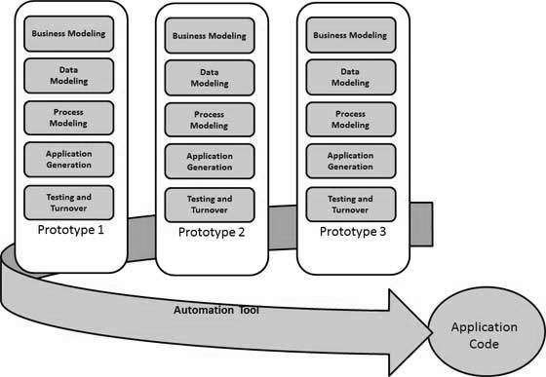
RAD Model
The following illustration describes the RAD Model in detail.
Notes:
Lesson descriptions should be brief.

Slide 64
RAD VS Traditional SDLC Models
The traditional SDLC follows a rigid process models with high emphasis on requirement analysis and gathering before the coding starts. It puts pressure on the customer to sign off the requirements before the project starts and the customer doesn’t get the feel of the product as there is no working build available for a long time.
The customer may need some changes after he gets to see the software. However, the change process is quite rigid and it may not be feasible to incorporate major changes in the product in the traditional SDLC.
The RAD model focuses on iterative and incremental delivery of working models to the customer. This results in rapid delivery to the customer and customer involvement during the complete development cycle of product reducing the risk of non-conformance with the actual user requirements.
Notes:
Example objectives
At the end of this lesson, you will be able to:
Save files to the team Web server.
Move files to different locations on the team Web server.
Share files on the team Web server.

Slide 65
RAD Model
RAD model can be applied successfully to the projects in which clear modularization is possible.
If the project cannot be broken into modules, RAD may fail. The following pointers describe the typical scenarios where RAD can be used −
RAD should be used only when a system can be modularized to be delivered in an incremental manner.
It should be used if there is a high availability of designers for modeling.
It should be used only if the budget permits use of automated code generating tools.
RAD SDLC model should be chosen only if domain experts are available with relevant business knowledge.
Should be used where the requirements change during the project and working prototypes are to be presented to customer in small iterations of 2-3 months.
Notes:
Lesson descriptions should be brief.

Slide 66
Rad Model Pros & Cons
RAD model enables rapid delivery as it reduces the overall development time due to the reusability of the components and parallel development.
RAD works well only if high skilled engineers are available and the customer is also committed to achieve the targeted prototype in the given time frame.
If there is commitment lacking on either side the model may fail.
Notes:
Example objectives
At the end of this lesson, you will be able to:
Save files to the team Web server.
Move files to different locations on the team Web server.
Share files on the team Web server.

Slide 67
Rad Model - Advantages
Changing requirements can be accommodated.
Progress can be measured.
Iteration time can be short with use of powerful RAD tools.
Productivity with fewer people in a short time.
Reduced development time.
Increases reusability of components.
Quick initial reviews occur.
Encourages customer feedback.
Integration from very beginning solves a lot of integration issues.
Notes:
Example objectives
At the end of this lesson, you will be able to:
Save files to the team Web server.
Move files to different locations on the team Web server.
Share files on the team Web server.

Slide 68
Rad Model - Advantages
Dependency on technically strong team members for identifying business requirements.
Only system that can be modularized can be built using RAD.
Requires highly skilled developers/designers.
High dependency on modeling skills.
Inapplicable to cheaper projects as cost of modeling and automated code generation is very high.
Management complexity is more.
Suitable for systems that are component based and scalable.
Requires user involvement throughout the life cycle.
Suitable for project requiring shorter development times.
Notes:
Example objectives
At the end of this lesson, you will be able to:
Save files to the team Web server.
Move files to different locations on the team Web server.
Share files on the team Web server.

Slide 69
Conclusion
The SDLC is a systematic process for building software that ensures the quality and correctness of the software built
The full form SDLC is Software Development Lifecycle.
SDLC process provides a framework for a standard set of activities and deliverables
Seven different SDLC stages are 1) Requirement collection and analysis 2) Feasibility study: 3) Design 4) Coding 5) Testing: 6) Installation/Deployment and 7) Maintenance
The senior team members conduct the requirement analysis phase
Feasibility Study stage includes everything which should be designed and developed during the project life cycle
Feasibility Study stage includes everything which should be designed and developed during the project life cycle
Notes:
Example objectives
At the end of this lesson, you will be able to:
Save files to the team Web server.
Move files to different locations on the team Web server.
Share files on the team Web server.

Slide 70
Conclusion
In the Design phase, the system and software design documents are prepared as per the requirement specification document
In the coding phase, developers start build the entire system by writing code using the chosen programming language
Testing is the next phase which is conducted to verify that the entire application works according to the customer requirement.
Installation and deployment face begins when the software testing phase is over, and no bugs or errors left in the system
Bug fixing, upgrade, and engagement actions covered in the maintenance face
Waterfall, Incremental, Agile, V model, Spiral, Big Bang are some of the popular SDLC models
SDLC consists of a detailed plan which explains how to plan, build, and maintain specific software
Notes:
Example objectives
At the end of this lesson, you will be able to:
Save files to the team Web server.
Move files to different locations on the team Web server.
Share files on the team Web server.

Slide 71
Unified Modeling Language (UML)
Notes:
How presentation will benefit audience: Adult learners are more interested in a subject if they know how or why it is important to them.
Presenter’s level of expertise in the subject: Briefly state your credentials in this area, or explain why participants should listen to you.

Slide 72
Unified Modeling Language
UML is a standard language for specifying, visualizing, constructing, and documenting the artifacts of software systems.
UML stands for Unified Modeling Language.
UML is different from the other common programming languages such as C++, Java, COBOL, etc.
UML is a pictorial language used to make software blueprints.
UML can be described as a general purpose visual modeling language to visualize, specify, construct, and document software system.
Although UML is generally used to model software systems, it is not limited within this boundary. It is also used to model non-software systems as well. For example, the process flow in a manufacturing unit, etc.
UML is not a programming language but tools can be used to generate code in various languages using UML diagrams.
UML has a direct relation with object oriented analysis and design. After some standardization, UML has become an OMG standard.
Notes:
How presentation will benefit audience: Adult learners are more interested in a subject if they know how or why it is important to them.
Presenter’s level of expertise in the subject: Briefly state your credentials in this area, or explain why participants should listen to you.

Slide 73
Goals of UML
A picture is worth a thousand words, this idiom absolutely fits describing UML. Object-oriented concepts were introduced much earlier than UML. At that point of time, there were no standard methodologies to organize and consolidate the object-oriented development. It was then that UML came into picture.
There are a number of goals for developing UML but the most important is to define some general purpose modeling language, which all modelers can use and it also needs to be made simple to understand and use.
UML diagrams are not only made for developers but also for business users, common people, and anybody interested to understand the system. The system can be a software or non-software system. Thus it must be clear that UML is not a development method rather it accompanies with processes to make it a successful system.
In conclusion, the goal of UML can be defined as a simple modeling mechanism to model all possible practical systems in today’s complex environment.
Notes:
How presentation will benefit audience: Adult learners are more interested in a subject if they know how or why it is important to them.
Presenter’s level of expertise in the subject: Briefly state your credentials in this area, or explain why participants should listen to you.

Slide 74
A Conceptual Model of UML
To understand the conceptual model of UML, first we need to clarify what is a conceptual model? and why a conceptual model is required?
A conceptual model can be defined as a model which is made of concepts and their relationships.
A conceptual model is the first step before drawing a UML diagram. It helps to understand the entities in the real world and how they interact with each other.
As UML describes the real-time systems, it is very important to make a conceptual model and then proceed gradually. The conceptual model of UML can be mastered by learning the following three major elements −
UML building blocks
Rules to connect the building blocks
Common mechanisms of UML
Notes:
How presentation will benefit audience: Adult learners are more interested in a subject if they know how or why it is important to them.
Presenter’s level of expertise in the subject: Briefly state your credentials in this area, or explain why participants should listen to you.

Slide 75
Object-Oriented Concepts
UML can be described as the successor of object-oriented (OO) analysis and design.
An object contains both data and methods that control the data. The data represents the state of the object. A class describes an object and they also form a hierarchy to model the real-world system. The hierarchy is represented as inheritance and the classes can also be associated in different ways as per the requirement.
Objects are the real-world entities that exist around us and the basic concepts such as abstraction, encapsulation, inheritance, and polymorphism all can be represented using UML.
UML is powerful enough to represent all the concepts that exist in object-oriented analysis and design. UML diagrams are representation of object-oriented concepts only. Thus, before learning UML, it becomes important to understand OO concept in detail.
Notes:
How presentation will benefit audience: Adult learners are more interested in a subject if they know how or why it is important to them.
Presenter’s level of expertise in the subject: Briefly state your credentials in this area, or explain why participants should listen to you.

Slide 76
Object-Oriented Concepts
Following are some fundamental concepts of the object-oriented world
Objects − Objects represent an entity and the basic building block.
Class − Class is the blue print of an object.
Abstraction − Abstraction represents the behavior of an real world entity.
Encapsulation − Encapsulation is the mechanism of binding the data together and hiding them from the outside world.
Inheritance − Inheritance is the mechanism of making new classes from existing ones.
Polymorphism − It defines the mechanism to exists in different forms.
Notes:
How presentation will benefit audience: Adult learners are more interested in a subject if they know how or why it is important to them.
Presenter’s level of expertise in the subject: Briefly state your credentials in this area, or explain why participants should listen to you.

Slide 77
OO Analysis and Design
OO can be defined as an investigation and to be more specific, it is the investigation of objects. Design means collaboration of identified objects.
Thus, it is important to understand the OO analysis and design concepts. The most important purpose of OO analysis is to identify objects of a system to be designed. This analysis is also done for an existing system.
Now an efficient analysis is only possible when we are able to start thinking in a way where objects can be identified. After identifying the objects, their relationships are identified and finally the design is produced.
Notes:
How presentation will benefit audience: Adult learners are more interested in a subject if they know how or why it is important to them.
Presenter’s level of expertise in the subject: Briefly state your credentials in this area, or explain why participants should listen to you.

Slide 78
OO Analysis and Design
The purpose of OO analysis and design can described as −
Identifying the objects of a system.
Identifying their relationships.
Making a design, which can be converted to executables using OO languages.
There are three basic steps where the OO concepts are applied and implemented. The steps can be defined as
OO Analysis → OO Design → OO implementation using OO languages
Notes:
How presentation will benefit audience: Adult learners are more interested in a subject if they know how or why it is important to them.
Presenter’s level of expertise in the subject: Briefly state your credentials in this area, or explain why participants should listen to you.

Slide 79
OO Analysis and Design
The above three points can be described in detail as −
During OO analysis, the most important purpose is to identify objects and describe them in a proper way. If these objects are identified efficiently, then the next job of design is easy. The objects should be identified with responsibilities. Responsibilities are the functions performed by the object. Each and every object has some type of responsibilities to be performed. When these responsibilities are collaborated, the purpose of the system is fulfilled.
The second phase is OO design. During this phase, emphasis is placed on the requirements and their fulfilment. In this stage, the objects are collaborated according to their intended association. After the association is complete, the design is also complete.
The third phase is OO implementation. In this phase, the design is implemented using OO languages such as Java, C++, etc.
Notes:
How presentation will benefit audience: Adult learners are more interested in a subject if they know how or why it is important to them.
Presenter’s level of expertise in the subject: Briefly state your credentials in this area, or explain why participants should listen to you.

Slide 80
Role of UML in OO Design
UML is a modeling language used to model software and non-software systems. Although UML is used for non-software systems, the emphasis is on modeling OO software applications. Most of the UML diagrams discussed so far are used to model different aspects such as static, dynamic, etc. Now whatever be the aspect, the artifacts are nothing but objects.
If we look into class diagram, object diagram, collaboration diagram, interaction diagrams all would basically be designed based on the objects.
Hence, the relation between OO design and UML is very important to understand. The OO design is transformed into UML diagrams according to the requirement. Before understanding the UML in detail, the OO concept should be learned properly. Once the OO analysis and design is done, the next step is very easy. The input from OO analysis and design is the input to UML diagrams.
Notes:
How presentation will benefit audience: Adult learners are more interested in a subject if they know how or why it is important to them.
Presenter’s level of expertise in the subject: Briefly state your credentials in this area, or explain why participants should listen to you.

Slide 81
UML-Building Blocks
UML is composed of three main building blocks, i.e., things, relationships, and diagrams. Building blocks generate one complete UML model diagram by rotating around several different blocks. It plays an essential role in developing UML diagrams. The basic UML building blocks are enlisted below:
Things
Relationships
Diagrams
Notes:
How presentation will benefit audience: Adult learners are more interested in a subject if they know how or why it is important to them.
Presenter’s level of expertise in the subject: Briefly state your credentials in this area, or explain why participants should listen to you.

Slide 82
Things
Anything that is a real world entity or object is termed as things. It can be divided into several different categories:
Structural things
Behavioral things
Grouping things
Annotational things
Notes:
How presentation will benefit audience: Adult learners are more interested in a subject if they know how or why it is important to them.
Presenter’s level of expertise in the subject: Briefly state your credentials in this area, or explain why participants should listen to you.

Slide 83
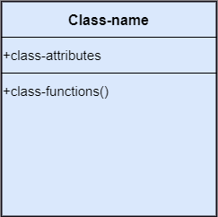
Structural things
Nouns that depicts the static behavior of a model is termed as structural things. They display the physical and conceptual components. They include class, object, interface, node, collaboration, component, and a use case.
Class: A Class is a set of identical things that outlines the functionality and properties of an object. It also represents the abstract class whose functionalities are not defined. Its notation is as follows;
Notes:
How presentation will benefit audience: Adult learners are more interested in a subject if they know how or why it is important to them.
Presenter’s level of expertise in the subject: Briefly state your credentials in this area, or explain why participants should listen to you.

Slide 84
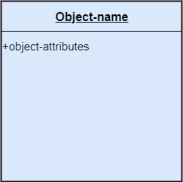
Structural things
Object:: An individual that describes the behavior and the functions of a system. The notation of the object is similar to that of the class; the only difference is that the object name is always underlined and its notation is given below;
Notes:
How presentation will benefit audience: Adult learners are more interested in a subject if they know how or why it is important to them.
Presenter’s level of expertise in the subject: Briefly state your credentials in this area, or explain why participants should listen to you.

Slide 85

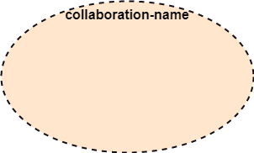
Structural things
Interface: A set of operations that describes the functionality of a class, which is implemented whenever an interface is implemented.
Collaboration: It represents the interaction between things that is done to meet the goal. It is symbolized as a dotted ellipse with its name written inside it.
Notes:
How presentation will benefit audience: Adult learners are more interested in a subject if they know how or why it is important to them.
Presenter’s level of expertise in the subject: Briefly state your credentials in this area, or explain why participants should listen to you.

Slide 86
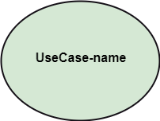
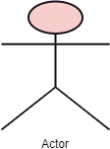
Structural things
Use case: Use case is the core concept of object-oriented modeling. It portrays a set of actions executed by a system to achieve the goal.
Actor: It comes under the use case diagrams. It is an object that interacts with the system, for example, a user.
Notes:
How presentation will benefit audience: Adult learners are more interested in a subject if they know how or why it is important to them.
Presenter’s level of expertise in the subject: Briefly state your credentials in this area, or explain why participants should listen to you.

Slide 87
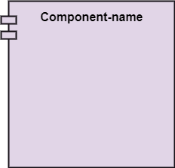
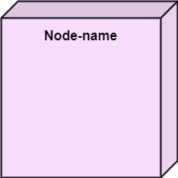
Structural things
Component: It represents the physical part of the system.
Node: A physical element that exists at run time.
Notes:
How presentation will benefit audience: Adult learners are more interested in a subject if they know how or why it is important to them.
Presenter’s level of expertise in the subject: Briefly state your credentials in this area, or explain why participants should listen to you.

Slide 88
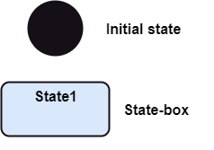
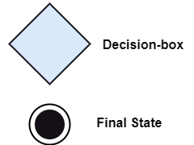
Behavioral Things
They are the verbs that encompass the dynamic parts of a model. It depicts the behavior of a system. They involve state machine, activity diagram, interaction diagram, grouping things, annotation things
State Machine: It defines a sequence of states that an entity goes through in the software development lifecycle. It keeps a record of several distinct states of a system component.
Notes:
How presentation will benefit audience: Adult learners are more interested in a subject if they know how or why it is important to them.
Presenter’s level of expertise in the subject: Briefly state your credentials in this area, or explain why participants should listen to you.

Slide 89
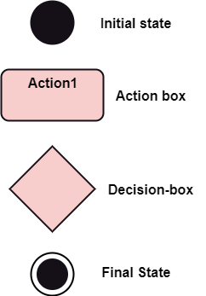
Behavioral Things
Activity Diagram: It portrays all the activities accomplished by different entities of a system. It is represented the same as that of a state machine diagram. It consists of an initial state, final state, a decision box, and an action notation.
Notes:
How presentation will benefit audience: Adult learners are more interested in a subject if they know how or why it is important to them.
Presenter’s level of expertise in the subject: Briefly state your credentials in this area, or explain why participants should listen to you.

Slide 90
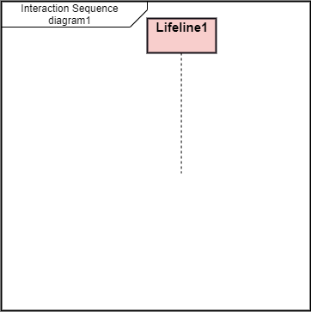
Behavioral Things
Interaction Diagram: It is used to envision the flow of messages between several components in a system.
Notes:
How presentation will benefit audience: Adult learners are more interested in a subject if they know how or why it is important to them.
Presenter’s level of expertise in the subject: Briefly state your credentials in this area, or explain why participants should listen to you.

Slide 91
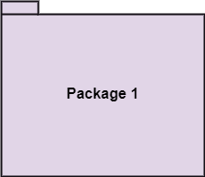
Grouping Things
It is a method that together binds the elements of the UML model. In UML, the package is the only thing, which is used for grouping.
Package: Package is the only thing that is available for grouping behavioral and structural things.
Notes:
How presentation will benefit audience: Adult learners are more interested in a subject if they know how or why it is important to them.
Presenter’s level of expertise in the subject: Briefly state your credentials in this area, or explain why participants should listen to you.

Slide 92
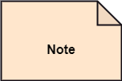
Annotation Things
It is a mechanism that captures the remarks, descriptions, and comments of UML model elements. In UML, a note is the only Annotational thing.
Note: It is used to attach the constraints, comments, and rules to the elements of the model. It is a kind of yellow sticky note.
Notes:
How presentation will benefit audience: Adult learners are more interested in a subject if they know how or why it is important to them.
Presenter’s level of expertise in the subject: Briefly state your credentials in this area, or explain why participants should listen to you.

Slide 93
Relationships
It illustrates the meaningful connections between things. It shows the association between the entities and defines the functionality of an application. There are four types of relationships given below:
Dependency: Dependency is a kind of relationship in which a change in target element affects the source element, or simply we can say the source element is dependent on the target element. It is one of the most important notations in UML. It depicts the dependency from one entity to another.
It is denoted by a dotted line followed by an arrow at one side as shown below,
Notes:
How presentation will benefit audience: Adult learners are more interested in a subject if they know how or why it is important to them.
Presenter’s level of expertise in the subject: Briefly state your credentials in this area, or explain why participants should listen to you.

Slide 94

Relationships
Association: A set of links that associates the entities to the UML model. It tells how many elements are actually taking part in forming that relationship.
It is denoted by a dotted line with arrowheads on both sides to describe the relationship with the element on both sides.
Generalization: It portrays the relationship between a general thing (a parent class or superclass) and a specific kind of that thing (a child class or subclass). It is used to describe the concept of inheritance.
It is denoted by a straight line followed by an empty arrowhead at one side.
Notes:
How presentation will benefit audience: Adult learners are more interested in a subject if they know how or why it is important to them.
Presenter’s level of expertise in the subject: Briefly state your credentials in this area, or explain why participants should listen to you.

Slide 95

Relationships
Realization: It is a semantic kind of relationship between two things, where one defines the behavior to be carried out, and the other one implements the mentioned behavior. It exists in interfaces.
It is denoted by a dotted line with an empty arrowhead at one side.
Notes:
How presentation will benefit audience: Adult learners are more interested in a subject if they know how or why it is important to them.
Presenter’s level of expertise in the subject: Briefly state your credentials in this area, or explain why participants should listen to you.

Slide 96
Diagrams
The diagrams are the graphical implementation of the models that incorporate symbols and text. Each symbol has a different meaning in the context of the UML diagram.
There are thirteen different types of UML diagrams that are available in UML 2.0, such that each diagram has its own set of a symbol. And each diagram manifests a different dimension, perspective, and view of the system.
UML diagrams are classified into three categories that are given below:
Structural Diagram
Behavioral Diagram
Interaction Diagram
Notes:
How presentation will benefit audience: Adult learners are more interested in a subject if they know how or why it is important to them.
Presenter’s level of expertise in the subject: Briefly state your credentials in this area, or explain why participants should listen to you.

Slide 97
Diagrams
Structural Diagram: It represents the static view of a system by portraying the structure of a system. It shows several objects residing in the system. Following are the structural diagrams given below:
Class diagram
Object diagram
Package diagram
Component diagram
Deployment diagram
Notes:
How presentation will benefit audience: Adult learners are more interested in a subject if they know how or why it is important to them.
Presenter’s level of expertise in the subject: Briefly state your credentials in this area, or explain why participants should listen to you.

Slide 98
Diagrams
Behavioral Diagram: It depicts the behavioral features of a system. It deals with dynamic parts of the system. It encompasses the following diagrams:
Activity diagram
State machine diagram
Use case diagram
Interaction diagram: It is a subset of behavioral diagrams. It depicts the interaction between two objects and the data flow between them. Following are the several interaction diagrams in UML:
Timing diagram
Sequence diagram
Collaboration diagram
Notes:
How presentation will benefit audience: Adult learners are more interested in a subject if they know how or why it is important to them.
Presenter’s level of expertise in the subject: Briefly state your credentials in this area, or explain why participants should listen to you.

Slide 99
UML- Architecture
Software architecture is all about how a software system is built at its highest level. It is needed to think big from multiple perspectives with quality and design in mind. The software team is tied to many practical concerns, such as:
The structure of the development team.
The needs of the business.
Development cycle.
The intent of the structure itself.
Notes:
How presentation will benefit audience: Adult learners are more interested in a subject if they know how or why it is important to them.
Presenter’s level of expertise in the subject: Briefly state your credentials in this area, or explain why participants should listen to you.

Slide 100
UML- Architecture
Software architecture provides a basic design of a complete software system.
It defines the elements included in the system, the functions each element has, and how each element relates to one another. In short, it is a big picture or overall structure of the whole system, how everything works together.
To form an architecture, the software architect will take several factors into consideration:
What will the system be used for?
Who will be using the system?
What quality matters to them?
Where will the system run?
Notes:
How presentation will benefit audience: Adult learners are more interested in a subject if they know how or why it is important to them.
Presenter’s level of expertise in the subject: Briefly state your credentials in this area, or explain why participants should listen to you.

Slide 101
UML- Architecture
The architect plans the structure of the system to meet the needs like these. It is essential to have proper software architecture, mainly for a large software system. Having a clear design of a complete system as a starting point provides a solid basis for developers to follow.
Each developer will know what needs to be implemented and how things relate to meet the desired needs efficiently. One of the main advantages of software architecture is that it provides high productivity to the software team.
The software development becomes more effective as it comes up with an explained structure in place to coordinate work, implement individual features, or ground discussions on potential issues.
With a lucid architecture, it is easier to know where the key responsibilities are residing in the system and where to make changes to add new requirements or simply fixing the failures.
Notes:
How presentation will benefit audience: Adult learners are more interested in a subject if they know how or why it is important to them.
Presenter’s level of expertise in the subject: Briefly state your credentials in this area, or explain why participants should listen to you.

Slide 102
UML- Architecture
In addition, a clear architecture will help to achieve quality in the software with a well-designed structure using principles like separation of concerns; the system becomes easier to maintain, reuse, and adapt.
The software architecture is useful to people such as software developers, the project manager, the client, and the end-user.
Each one will have different perspectives to view the system and will bring different agendas to a project. Also, it provides a collection of several views. It can be best understood as a collection of five views:
Use case view
Design view
Implementation view
Process view
Development view
Notes:
How presentation will benefit audience: Adult learners are more interested in a subject if they know how or why it is important to them.
Presenter’s level of expertise in the subject: Briefly state your credentials in this area, or explain why participants should listen to you.

Slide 103
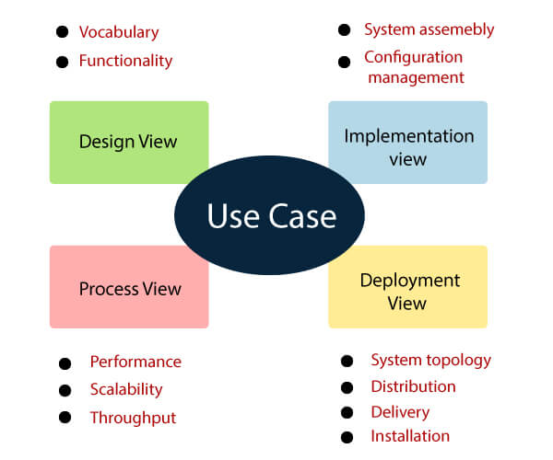
UML- Architecture
Notes:
How presentation will benefit audience: Adult learners are more interested in a subject if they know how or why it is important to them.
Presenter’s level of expertise in the subject: Briefly state your credentials in this area, or explain why participants should listen to you.

Slide 104
UML- Architecture
Use case view
It is a view that shows the functionality of the system as perceived by external actors.
It reveals the requirements of the system.
With UML, it is easy to capture the static aspects of this view in the use case diagrams, whereas it?s dynamic aspects are captured in interaction diagrams, state chart diagrams, and activity diagrams.
Design View
It is a view that shows how the functionality is designed inside the system in terms of static structure and dynamic behavior.
It captures the vocabulary of the problem space and solution space.
With UML, it represents the static aspects of this view in class and object diagrams, whereas its dynamic aspects are captured in interaction diagrams, state chart diagrams, and activity diagrams.
Notes:
How presentation will benefit audience: Adult learners are more interested in a subject if they know how or why it is important to them.
Presenter’s level of expertise in the subject: Briefly state your credentials in this area, or explain why participants should listen to you.

Slide 105
UML- Architecture
Implementation View
It is the view that represents the organization of the core components and files.
It primarily addresses the configuration management of the system?s releases.
With UML, its static aspects are expressed in component diagrams, and the dynamic aspects are captured in interaction diagrams, state chart diagrams, and activity diagrams.
Process View
It is the view that demonstrates the concurrency of the system.
It incorporates the threads and processes that make concurrent system and synchronized mechanisms.
It primarily addresses the system's scalability, throughput, and performance.
Its static and dynamic aspects are expressed the same way as the design view but focus more on the active classes that represent these threads and processes.
Notes:
How presentation will benefit audience: Adult learners are more interested in a subject if they know how or why it is important to them.
Presenter’s level of expertise in the subject: Briefly state your credentials in this area, or explain why participants should listen to you.

Slide 106
UML- Architecture
Deployment View
It is the view that shows the deployment of the system in terms of physical architecture.
It includes the nodes, which form the system hardware topology where the system will be executed.
It primarily addresses the distribution, delivery, and installation of the parts that build the physical system.
Notes:
How presentation will benefit audience: Adult learners are more interested in a subject if they know how or why it is important to them.
Presenter’s level of expertise in the subject: Briefly state your credentials in this area, or explain why participants should listen to you.

Slide 107
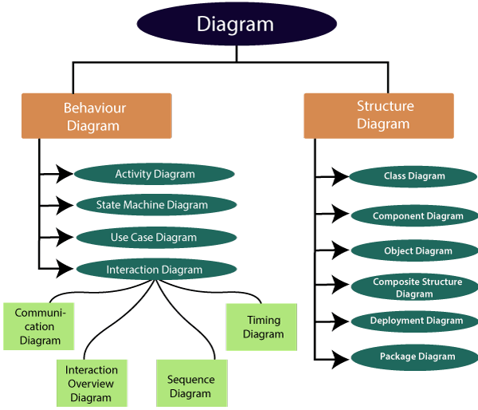
UML-Diagrams
The UML diagrams are categorized into structural diagrams, behavioral diagrams, and also interaction overview diagrams. The diagrams are hierarchically classified in the following figure:
Notes:
How presentation will benefit audience: Adult learners are more interested in a subject if they know how or why it is important to them.
Presenter’s level of expertise in the subject: Briefly state your credentials in this area, or explain why participants should listen to you.

Slide 108
Structural Diagrams
Structural diagrams depict a static view or structure of a system. It is widely used in the documentation of software architecture. It embraces class diagrams, composite structure diagrams, component diagrams, deployment diagrams, object diagrams, and package diagrams. It presents an outline for the system. It stresses the elements to be present that are to be modeled.
Class Diagram: Class diagrams are one of the most widely used diagrams. It is the backbone of all the object-oriented software systems. It depicts the static structure of the system. It displays the system's class, attributes, and methods. It is helpful in recognizing the relation between different objects as well as classes.
Composite Structure Diagram: The composite structure diagrams show parts within the class. It displays the relationship between the parts and their configuration that ascertain the behavior of the class. It makes full use of ports, parts, and connectors to portray the internal structure of a structured classifier. It is similar to class diagrams, just the fact it represents individual parts in a detailed manner when compared with class diagrams.
Notes:
How presentation will benefit audience: Adult learners are more interested in a subject if they know how or why it is important to them.
Presenter’s level of expertise in the subject: Briefly state your credentials in this area, or explain why participants should listen to you.

Slide 109
Structural Diagrams
Object Diagram: It describes the static structure of a system at a particular point in time. It can be used to test the accuracy of class diagrams. It represents distinct instances of classes and the relationship between them at a time.
Component Diagram: It portrays the organization of the physical components within the system. It is used for modeling execution details. It determines whether the desired functional requirements have been considered by the planned development or not, as it depicts the structural relationships between the elements of a software system.
Deployment Diagram: It presents the system's software and its hardware by telling what the existing physical components are and what software components are running on them. It produces information about system software. It is incorporated whenever software is used, distributed, or deployed across multiple machines with dissimilar configurations.
Package Diagram: It is used to illustrate how the packages and their elements are organized. It shows the dependencies between distinct packages. It manages UML diagrams by making it easily understandable. It is used for organizing the class and use case diagrams.
Notes:
How presentation will benefit audience: Adult learners are more interested in a subject if they know how or why it is important to them.
Presenter’s level of expertise in the subject: Briefly state your credentials in this area, or explain why participants should listen to you.

Slide 110
Behavioral Diagrams
Behavioral diagrams portray a dynamic view of a system or the behavior of a system, which describes the functioning of the system. It includes use case diagrams, state diagrams, and activity diagrams. It defines the interaction within the system.
State Machine Diagram: It is a behavioral diagram. it portrays the system's behavior utilizing finite state transitions. It is also known as the State-charts diagram. It models the dynamic behavior of a class in response to external stimuli.
Activity Diagram: It models the flow of control from one activity to the other. With the help of an activity diagram, we can model sequential and concurrent activities. It visually depicts the workflow as well as what causes an event to occur.
Use Case Diagram: It represents the functionality of a system by utilizing actors and use cases. It encapsulates the functional requirement of a system and its association with actors. It portrays the use case view of a system.
Notes:
How presentation will benefit audience: Adult learners are more interested in a subject if they know how or why it is important to them.
Presenter’s level of expertise in the subject: Briefly state your credentials in this area, or explain why participants should listen to you.

Slide 111
Interaction Diagrams
Interaction diagrams are a subclass of behavioral diagrams that give emphasis to object interactions and also depicts the flow between various use case elements of a system. In simple words, it shows how objects interact with each other and how the data flows within them. It consists of communication, interaction overview, sequence, and timing diagrams.
Sequence Diagram: It shows the interactions between the objects in terms of messages exchanged over time. It delineates in what order and how the object functions are in a system.
Communication Diagram: It shows the interchange of sequence messages between the objects. It focuses on objects and their relations. It describes the static and dynamic behavior of a system.
Timing Diagram: It is a special kind of sequence diagram used to depict the object's behavior over a specific period of time. It governs the change in state and object behavior by showing the time and duration constraints.
Interaction Overview diagram: It is a mixture of activity and sequence diagram that depicts a sequence of actions to simplify the complex interactions into simple interactions.
Notes:
How presentation will benefit audience: Adult learners are more interested in a subject if they know how or why it is important to them.
Presenter’s level of expertise in the subject: Briefly state your credentials in this area, or explain why participants should listen to you.

Slide 112
UML Class Diagram
The class diagram depicts a static view of an application. It represents the types of objects residing in the system and the relationships between them. A class consists of its objects, and also it may inherit from other classes. A class diagram is used to visualize, describe, document various different aspects of the system, and also construct executable software code.
It shows the attributes, classes, functions, and relationships to give an overview of the software system. It constitutes class names, attributes, and functions in a separate compartment that helps in software development. Since it is a collection of classes, interfaces, associations, collaborations, and constraints, it is termed as a structural diagram.
Notes:
How presentation will benefit audience: Adult learners are more interested in a subject if they know how or why it is important to them.
Presenter’s level of expertise in the subject: Briefly state your credentials in this area, or explain why participants should listen to you.

Slide 113
Purpose of Class Diagrams
The main purpose of class diagrams is to build a static view of an application. It is the only diagram that is widely used for construction, and it can be mapped with object-oriented languages.
It is one of the most popular UML diagrams. Following are the purpose of class diagrams given below:
It analyses and designs a static view of an application.
It describes the major responsibilities of a system.
It is a base for component and deployment diagrams.
It incorporates forward and reverse engineering.
Notes:
How presentation will benefit audience: Adult learners are more interested in a subject if they know how or why it is important to them.
Presenter’s level of expertise in the subject: Briefly state your credentials in this area, or explain why participants should listen to you.

Slide 114
Benefits of Class Diagrams
It can represent the object model for complex systems.
It reduces the maintenance time by providing an overview of how an application is structured before coding.
It provides a general schematic of an application for better understanding.
It represents a detailed chart by highlighting the desired code, which is to be programmed.
It is helpful for the stakeholders and the developers.
Notes:
How presentation will benefit audience: Adult learners are more interested in a subject if they know how or why it is important to them.
Presenter’s level of expertise in the subject: Briefly state your credentials in this area, or explain why participants should listen to you.

Slide 115
Vital components of a Class Diagram
Upper Section: The upper section encompasses the name of the class. A class is a representation of similar objects that shares the same relationships, attributes, operations, and semantics. Some of the following rules that should be taken into account while representing a class are given below:
Capitalize the initial letter of the class name.
Place the class name in the center of the upper section.
A class name must be written in bold format.
The name of the abstract class should be written in italics format.
Middle Section: The middle section constitutes the attributes, which describe the quality of the class. The attributes have the following characteristics:
The attributes are written along with its visibility factors, which are public (+), private (-), protected (#), and package (~).
The accessibility of an attribute class is illustrated by the visibility factors.
A meaningful name should be assigned to the attribute, which will explain its usage inside the class.
Notes:
How presentation will benefit audience: Adult learners are more interested in a subject if they know how or why it is important to them.
Presenter’s level of expertise in the subject: Briefly state your credentials in this area, or explain why participants should listen to you.

Slide 116
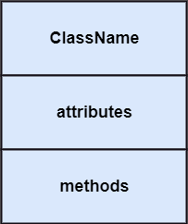
Vital components of a Class Diagram
Lower Section: The lower section contain methods or operations. The methods are represented in the form of a list, where each method is written in a single line. It demonstrates how a class interacts with data.
Notes:
How presentation will benefit audience: Adult learners are more interested in a subject if they know how or why it is important to them.
Presenter’s level of expertise in the subject: Briefly state your credentials in this area, or explain why participants should listen to you.

Slide 117

Relationships
In UML, relationships are of three types:
Dependency: A dependency is a semantic relationship between two or more classes where a change in one class cause changes in another class. It forms a weaker relationship. In the following example, Student_Name is dependent on the Student_Id.
Notes:
How presentation will benefit audience: Adult learners are more interested in a subject if they know how or why it is important to them.
Presenter’s level of expertise in the subject: Briefly state your credentials in this area, or explain why participants should listen to you.

Slide 118
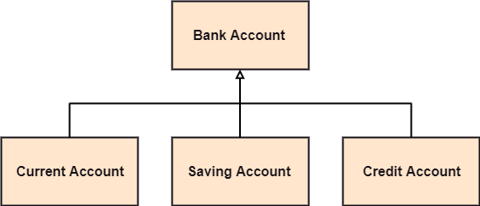
Relationships
Generalization: A generalization is a relationship between a parent class (superclass) and a child class (subclass). In this, the child class is inherited from the parent class. For example, The Current Account, Saving Account, and Credit Account are the generalized form of Bank Account.
Notes:
How presentation will benefit audience: Adult learners are more interested in a subject if they know how or why it is important to them.
Presenter’s level of expertise in the subject: Briefly state your credentials in this area, or explain why participants should listen to you.

Slide 119

Relationships
Association: It describes a static or physical connection between two or more objects. It depicts how many objects are there in the relationship. For example, a department is associated with the college.
Notes:
How presentation will benefit audience: Adult learners are more interested in a subject if they know how or why it is important to them.
Presenter’s level of expertise in the subject: Briefly state your credentials in this area, or explain why participants should listen to you.

Slide 120
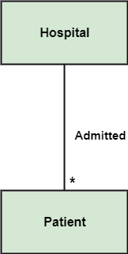
Relationships
Multiplicity: It defines a specific range of allowable instances of attributes. In case if a range is not specified, one is considered as a default multiplicity.
For example, multiple patients are admitted to one hospital.
Notes:
How presentation will benefit audience: Adult learners are more interested in a subject if they know how or why it is important to them.
Presenter’s level of expertise in the subject: Briefly state your credentials in this area, or explain why participants should listen to you.

Slide 121

Relationships
Aggregation: An aggregation is a subset of association, which represents has a relationship. It is more specific then association. It defines a part-whole or part-of relationship. In this kind of relationship, the child class can exist independently of its parent class.
The company encompasses a number of employees, and even if one employee resigns, the company still exists.
Notes:
How presentation will benefit audience: Adult learners are more interested in a subject if they know how or why it is important to them.
Presenter’s level of expertise in the subject: Briefly state your credentials in this area, or explain why participants should listen to you.

Slide 122

Relationships
Composition: The composition is a subset of aggregation. It portrays the dependency between the parent and its child, which means if one part is deleted, then the other part also gets discarded. It represents a whole-part relationship.
A contact book consists of multiple contacts, and if you delete the contact book, all the contacts will be lost.
Notes:
How presentation will benefit audience: Adult learners are more interested in a subject if they know how or why it is important to them.
Presenter’s level of expertise in the subject: Briefly state your credentials in this area, or explain why participants should listen to you.

Slide 123
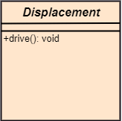
Abstract Classes
In the abstract class, no objects can be a direct entity of the abstract class. The abstract class can neither be declared nor be instantiated.
It is used to find the functionalities across the classes. The notation of the abstract class is similar to that of class; the only difference is that the name of the class is written in italics.
Since it does not involve any implementation for a given function, it is best to use the abstract class with multiple objects.
Let us assume that we have an abstract class named displacement with a method declared inside it, and that method will be called as a drive (). Now, this abstract class method can be implemented by any object, for example, car, bike, scooter, cycle, etc.
Notes:
How presentation will benefit audience: Adult learners are more interested in a subject if they know how or why it is important to them.
Presenter’s level of expertise in the subject: Briefly state your credentials in this area, or explain why participants should listen to you.

Slide 124
How to draw a Class Diagram?
The class diagram is used most widely to construct software applications. It not only represents a static view of the system but also all the major aspects of an application. A collection of class diagrams as a whole represents a system.
Some key points that are needed to keep in mind while drawing a class diagram are given below:
To describe a complete aspect of the system, it is suggested to give a meaningful name to the class diagram.
The objects and their relationships should be acknowledged in advance.
The attributes and methods (responsibilities) of each class must be known.
A minimum number of desired properties should be specified as more number of the unwanted property will lead to a complex diagram.
Notes can be used as and when required by the developer to describe the aspects of a diagram.
The diagrams should be redrawn and reworked as many times to make it correct before producing its final version.
Notes:
How presentation will benefit audience: Adult learners are more interested in a subject if they know how or why it is important to them.
Presenter’s level of expertise in the subject: Briefly state your credentials in this area, or explain why participants should listen to you.

Slide 125
Class Diagram Example
A class diagram describing the sales order system is given below.
Notes:
How presentation will benefit audience: Adult learners are more interested in a subject if they know how or why it is important to them.
Presenter’s level of expertise in the subject: Briefly state your credentials in this area, or explain why participants should listen to you.

Slide 126
Usage of Class diagrams
The class diagram is used to represent a static view of the system.
It plays an essential role in the establishment of the component and deployment diagrams.
It helps to construct an executable code to perform forward and backward engineering for any system, or we can say it is mainly used for construction.
It represents the mapping with object-oriented languages that are C++, Java, etc.
Class diagrams can be used for the following purposes:
To describe the static view of a system.
To show the collaboration among every instance in the static view.
To describe the functionalities performed by the system.
To construct the software application using object-oriented languages.
Notes:
How presentation will benefit audience: Adult learners are more interested in a subject if they know how or why it is important to them.
Presenter’s level of expertise in the subject: Briefly state your credentials in this area, or explain why participants should listen to you.

Slide 127
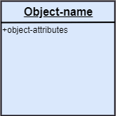
UML Object Diagram
Object diagrams are dependent on the class diagram as they are derived from the class diagram. It represents an instance of a class diagram. The objects help in portraying a static view of an object-oriented system at a specific instant.
Both the object and class diagram are similar to some extent; the only difference is that the class diagram provides an abstract view of a system. It helps in visualizing a particular functionality of a system.
Notation of an Object Diagram :
Notes:
How presentation will benefit audience: Adult learners are more interested in a subject if they know how or why it is important to them.
Presenter’s level of expertise in the subject: Briefly state your credentials in this area, or explain why participants should listen to you.

Slide 128
Purpose of Object Diagram
The object diagram holds the same purpose as that of a class diagram. The class diagram provides an abstract view which comprises of classes and their relationships, whereas the object diagram represents an instance at a particular point of time.
The object diagram is actually similar to the concrete (actual) system behavior. The main purpose is to depict a static view of a system.
Following are the purposes enlisted below:
It is used to perform forward and reverse engineering.
It is used to understand object behavior and their relationships practically.
It is used to get a static view of a system.
It is used to represent an instance of a system.
Notes:
How presentation will benefit audience: Adult learners are more interested in a subject if they know how or why it is important to them.
Presenter’s level of expertise in the subject: Briefly state your credentials in this area, or explain why participants should listen to you.

Slide 129
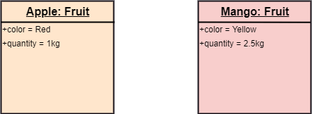
Example of Object Diagram
Notes:
How presentation will benefit audience: Adult learners are more interested in a subject if they know how or why it is important to them.
Presenter’s level of expertise in the subject: Briefly state your credentials in this area, or explain why participants should listen to you.

Slide 130
How to draw an Object Diagram?
All the objects present in the system should be examined before start drawing the object diagram.
Before creating the object diagram, the relation between the objects must be acknowledged.
The association relationship among the entities must be cleared already.
To represent the functionality of an object, a proper meaningful name should be assigned.
The objects are to be examined to understand its functionality.
Notes:
How presentation will benefit audience: Adult learners are more interested in a subject if they know how or why it is important to them.
Presenter’s level of expertise in the subject: Briefly state your credentials in this area, or explain why participants should listen to you.

Slide 131
Applications of Object diagrams
The following are the application areas where the object diagrams can be used.
To build a prototype of a system.
To model complex data structures.
To perceive the system from a practical perspective.
Reverse engineering.
Notes:
How presentation will benefit audience: Adult learners are more interested in a subject if they know how or why it is important to them.
Presenter’s level of expertise in the subject: Briefly state your credentials in this area, or explain why participants should listen to you.

Slide 132
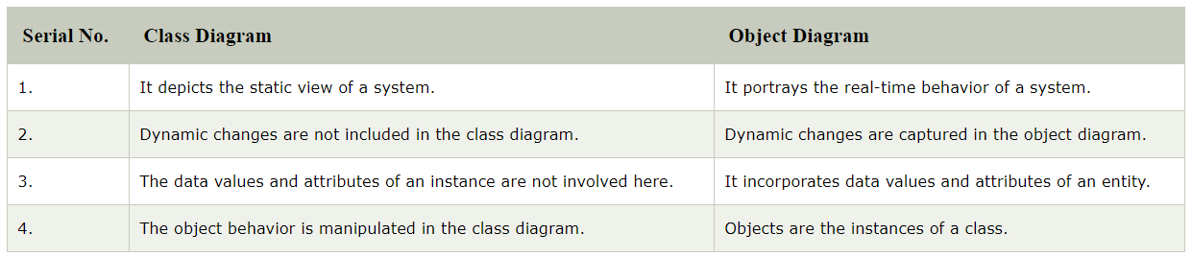
Class vs. Object diagram
Notes:
How presentation will benefit audience: Adult learners are more interested in a subject if they know how or why it is important to them.
Presenter’s level of expertise in the subject: Briefly state your credentials in this area, or explain why participants should listen to you.

Slide 133
UML Use Case Diagram
A use case diagram is used to represent the dynamic behavior of a system.
It encapsulates the system's functionality by incorporating use cases, actors, and their relationships.
It models the tasks, services, and functions required by a system/subsystem of an application.
It depicts the high-level functionality of a system and also tells how the user handles a system.
Notes:
How presentation will benefit audience: Adult learners are more interested in a subject if they know how or why it is important to them.
Presenter’s level of expertise in the subject: Briefly state your credentials in this area, or explain why participants should listen to you.

Slide 134
Purpose of Use Case Diagrams
The main purpose of a use case diagram is to portray the dynamic aspect of a system.
It accumulates the system's requirement, which includes both internal as well as external influences. It invokes persons, use cases, and several things that invoke the actors and elements accountable for the implementation of use case diagrams.
It represents how an entity from the external environment can interact with a part of the system.
It gathers the system's needs.
It depicts the external view of the system.
It recognizes the internal as well as external factors that influence the system.
It represents the interaction between the actors.
Notes:
How presentation will benefit audience: Adult learners are more interested in a subject if they know how or why it is important to them.
Presenter’s level of expertise in the subject: Briefly state your credentials in this area, or explain why participants should listen to you.

Slide 135
How to draw a Use Case diagram?
It is essential to analyze the whole system before starting with drawing a use case diagram, and then the system's functionalities are found. And once every single functionality is identified, they are then transformed into the use cases to be used in the use case diagram.
After that, we will enlist the actors that will interact with the system. The actors are the person or a thing that invokes the functionality of a system. It may be a system or a private entity, such that it requires an entity to be pertinent to the functionalities of the system to which it is going to interact.
Once both the actors and use cases are enlisted, the relation between the actor and use case/ system is inspected. It identifies the no of times an actor communicates with the system. Basically, an actor can interact multiple times with a use case or system at a particular instance of time.
Notes:
How presentation will benefit audience: Adult learners are more interested in a subject if they know how or why it is important to them.
Presenter’s level of expertise in the subject: Briefly state your credentials in this area, or explain why participants should listen to you.

Slide 136
How to draw a Use Case diagram?
Following are some rules that must be followed while drawing a use case diagram:
A pertinent and meaningful name should be assigned to the actor or a use case of a system.
The communication of an actor with a use case must be defined in an understandable way.
Specified notations to be used as and when required.
The most significant interactions should be represented among the multiple no of interactions between the use case and actors.
Notes:
How presentation will benefit audience: Adult learners are more interested in a subject if they know how or why it is important to them.
Presenter’s level of expertise in the subject: Briefly state your credentials in this area, or explain why participants should listen to you.

Slide 137
Example of a Use Case Diagram
A use case diagram depicting the Online Shopping website is given below.
Here the Web Customer actor makes use of any online shopping website to purchase online.
The top-level uses are as follows; View Items, Make Purchase, Checkout, Client Register.
The View Items use case is utilized by the customer who searches and view products.
The Client Register use case allows the customer to register itself with the website for availing gift vouchers, coupons, or getting a private sale invitation.
It is to be noted that the Checkout is an included use case, which is part of Making Purchase, and it is not available by itself.
Notes:
How presentation will benefit audience: Adult learners are more interested in a subject if they know how or why it is important to them.
Presenter’s level of expertise in the subject: Briefly state your credentials in this area, or explain why participants should listen to you.

Slide 138
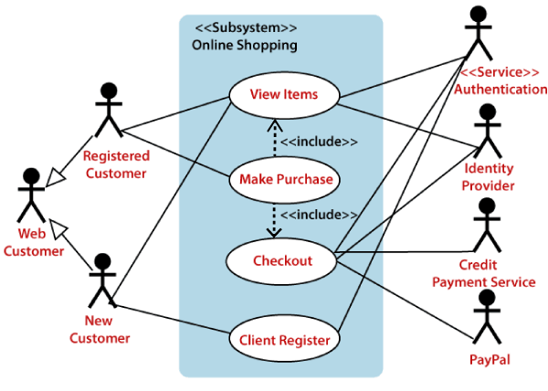
Example of a Use Case Diagram
Notes:
How presentation will benefit audience: Adult learners are more interested in a subject if they know how or why it is important to them.
Presenter’s level of expertise in the subject: Briefly state your credentials in this area, or explain why participants should listen to you.

Slide 139
Example of a Use Case Diagram
The View Items is further extended by several use cases such as; Search Items, Browse Items, View Recommended Items, Add to Shopping Cart, Add to Wish list.
All of these extended use cases provide some functions to customers, which allows them to search for an item.
Both View Recommended Item and Add to Wish List include the Customer Authentication use case, as they necessitate authenticated customers, and simultaneously item can be added to the shopping cart without any user authentication.
Notes:
How presentation will benefit audience: Adult learners are more interested in a subject if they know how or why it is important to them.
Presenter’s level of expertise in the subject: Briefly state your credentials in this area, or explain why participants should listen to you.

Slide 140
Example of a Use Case Diagram
Notes:
How presentation will benefit audience: Adult learners are more interested in a subject if they know how or why it is important to them.
Presenter’s level of expertise in the subject: Briefly state your credentials in this area, or explain why participants should listen to you.

Slide 141
Example of a Use Case Diagram
Similarly, the Checkout use case also includes the following use cases, as shown below. It requires an authenticated Web Customer, which can be done by login page, user authentication cookie ("Remember me"), or Single Sign-On (SSO).
SSO needs an external identity provider's participation, while Web site authentication service is utilized in all these use cases.
The Checkout use case involves Payment use case that can be done either by the credit card and external credit payment services or with PayPal.
Notes:
How presentation will benefit audience: Adult learners are more interested in a subject if they know how or why it is important to them.
Presenter’s level of expertise in the subject: Briefly state your credentials in this area, or explain why participants should listen to you.

Slide 142
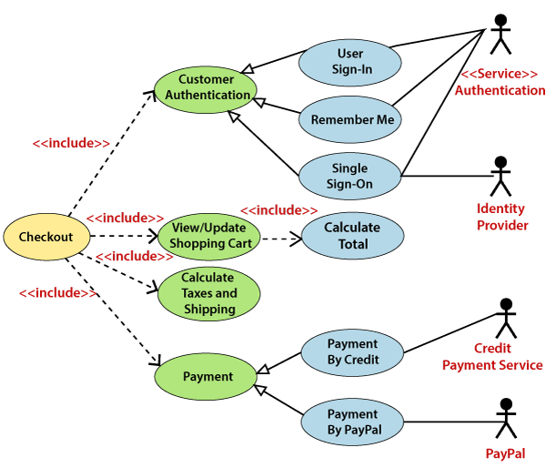
Example of a Use Case Diagram
Notes:
How presentation will benefit audience: Adult learners are more interested in a subject if they know how or why it is important to them.
Presenter’s level of expertise in the subject: Briefly state your credentials in this area, or explain why participants should listen to you.

Slide 143
Important tips for drawing a Use Case diagram
Following are some important tips that are to be kept in mind while drawing a use case diagram:
A simple and complete use case diagram should be articulated.
A use case diagram should represent the most significant interaction among the multiple interactions.
At least one module of a system should be represented by the use case diagram.
If the use case diagram is large and more complex, then it should be drawn more generalized.
Notes:
How presentation will benefit audience: Adult learners are more interested in a subject if they know how or why it is important to them.
Presenter’s level of expertise in the subject: Briefly state your credentials in this area, or explain why participants should listen to you.

Slide 144
UML Activity Diagram
In UML, the activity diagram is used to demonstrate the flow of control within the system rather than the implementation. It models the concurrent and sequential activities.
The activity diagram helps in envisioning the workflow from one activity to another. It put emphasis on the condition of flow and the order in which it occurs. The flow can be sequential, branched, or concurrent, and to deal with such kinds of flows, the activity diagram has come up with a fork, join, etc.
It is also termed as an object-oriented flowchart. It encompasses activities composed of a set of actions or operations that are applied to model the behavioral diagram.
Notes:
How presentation will benefit audience: Adult learners are more interested in a subject if they know how or why it is important to them.
Presenter’s level of expertise in the subject: Briefly state your credentials in this area, or explain why participants should listen to you.

Slide 145

Components of an Activity Diagram
Following are the component of an activity diagram:
Activities
The categorization of behavior into one or more actions is termed as an activity. In other words, it can be said that an activity is a network of nodes that are connected by edges. The edges depict the flow of execution. It may contain action nodes, control nodes, or object nodes.
The control flow of activity is represented by control nodes and object nodes that illustrates the objects used within an activity. The activities are initiated at the initial node and are terminated at the final node.
Notes:
How presentation will benefit audience: Adult learners are more interested in a subject if they know how or why it is important to them.
Presenter’s level of expertise in the subject: Briefly state your credentials in this area, or explain why participants should listen to you.

Slide 146
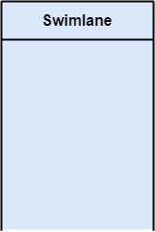
Components of an Activity Diagram
Activity partition /swimlane
The swimlane is used to cluster all the related activities in one column or one row. It can be either vertical or horizontal. It used to add modularity to the activity diagram.
It is not necessary to incorporate swimlane in the activity diagram. But it is used to add more transparency to the activity diagram.
Notes:
How presentation will benefit audience: Adult learners are more interested in a subject if they know how or why it is important to them.
Presenter’s level of expertise in the subject: Briefly state your credentials in this area, or explain why participants should listen to you.

Slide 147
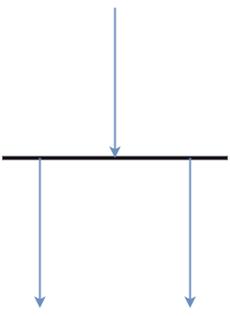
Components of an Activity Diagram
Forks
Forks and join nodes generate the concurrent flow inside the activity. A fork node consists of one inward edge and several outward edges. It is the same as that of various decision parameters.
Whenever a data is received at an inward edge, it gets copied and split crossways various outward edges. It split a single inward flow into multiple parallel flows.
Notes:
How presentation will benefit audience: Adult learners are more interested in a subject if they know how or why it is important to them.
Presenter’s level of expertise in the subject: Briefly state your credentials in this area, or explain why participants should listen to you.

Slide 148
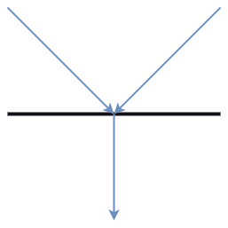
Components of an Activity Diagram
Join Nodes
Join nodes are the opposite of fork nodes. A Logical AND operation is performed on all of the inward edges as it synchronizes the flow of input across one single output (outward) edge.
Pins
It is a small rectangle, which is attached to the action rectangle. It clears out all the messy and complicated thing to manage the execution flow of activities. It is an object node that precisely represents one input to or output from the action.
Notes:
How presentation will benefit audience: Adult learners are more interested in a subject if they know how or why it is important to them.
Presenter’s level of expertise in the subject: Briefly state your credentials in this area, or explain why participants should listen to you.

Slide 149
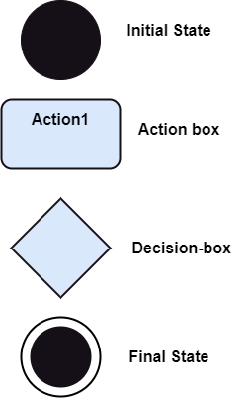
Notation of an Activity diagram
Activity diagram constitutes following notations:
Initial State: It depicts the initial stage or beginning of the set of actions.
Final State: It is the stage where all the control flows and object flows end.
Decision Box: It makes sure that the control flow or object flow will follow only one path.
Action Box: It represents the set of actions that are to be performed.
Notes:
How presentation will benefit audience: Adult learners are more interested in a subject if they know how or why it is important to them.
Presenter’s level of expertise in the subject: Briefly state your credentials in this area, or explain why participants should listen to you.

Slide 150
Why use Activity Diagram?
An event is created as an activity diagram encompassing a group of nodes associated with edges. To model the behavior of activities, they can be attached to any modeling element. It can model use cases, classes, interfaces, components, and collaborations.
It mainly models processes and workflows. It envisions the dynamic behavior of the system as well as constructs a runnable system that incorporates forward and reverse engineering. It does not include the message part, which means message flow is not represented in an activity diagram.
It is the same as that of a flowchart but not exactly a flowchart itself. It is used to depict the flow between several activities.
Notes:
How presentation will benefit audience: Adult learners are more interested in a subject if they know how or why it is important to them.
Presenter’s level of expertise in the subject: Briefly state your credentials in this area, or explain why participants should listen to you.

Slide 151
How to draw an Activity Diagram?
An activity diagram is a flowchart of activities, as it represents the workflow among various activities. They are identical to the flowcharts, but they themself are not exactly the flowchart.
In other words, it can be said that an activity diagram is an enhancement of the flowchart, which encompasses several unique skills.
Since it incorporates swimlanes, branching, parallel flows, join nodes, control nodes, and forks, it supports exception handling. A system must be explored as a whole before drawing an activity diagram to provide a clearer view of the user.
All of the activities are explored after they are properly analyzed for finding out the constraints applied to the activities. Each and every activity, condition, and association must be recognized.
Notes:
How presentation will benefit audience: Adult learners are more interested in a subject if they know how or why it is important to them.
Presenter’s level of expertise in the subject: Briefly state your credentials in this area, or explain why participants should listen to you.

Slide 152
How to draw an Activity Diagram?
After gathering all the essential information, an abstract or a prototype is built, which is then transformed into the actual diagram.
Following are the rules that are to be followed for drawing an activity diagram:
A meaningful name should be given to each and every activity.
Identify all of the constraints.
Acknowledge the activity associations.
Notes:
How presentation will benefit audience: Adult learners are more interested in a subject if they know how or why it is important to them.
Presenter’s level of expertise in the subject: Briefly state your credentials in this area, or explain why participants should listen to you.

Slide 153
Example of an Activity Diagram
An example of an activity diagram showing the business flow activity of order processing is given below.
Here the input parameter is the Requested order, and once the order is accepted, all of the required information is then filled, payment is also accepted, and then the order is shipped. It permits order shipment before an invoice is sent or payment is completed.
Notes:
How presentation will benefit audience: Adult learners are more interested in a subject if they know how or why it is important to them.
Presenter’s level of expertise in the subject: Briefly state your credentials in this area, or explain why participants should listen to you.

Slide 154
When to use an Activity Diagram?
An activity diagram can be used to portray business processes and workflows. Also, it used for modeling business as well as the software. An activity diagram is utilized for the followings:
To graphically model the workflow in an easier and understandable way.
To model the execution flow among several activities.
To model comprehensive information of a function or an algorithm employed within the system.
To model the business process and its workflow.
To envision the dynamic aspect of a system.
To generate the top-level flowcharts for representing the workflow of an application.
To represent a high-level view of a distributed or an object-oriented system.
Notes:
How presentation will benefit audience: Adult learners are more interested in a subject if they know how or why it is important to them.
Presenter’s level of expertise in the subject: Briefly state your credentials in this area, or explain why participants should listen to you.

Slide 155
